Slide 1
An Analysis of MSHA Fatality Reports: Are We Safely Going in the Right Direction?
Nathan Kelley¹, Mark Savit², Eric Lutz³, Pedram Roghanchi¹
¹ University of Kentucky, Lexington KY
² Predictive Compliance, Denver CO
³ University of Arizona, Tucson AZ

Slide 2
Acknowledgements
This study was funded by the National Institute for Occupational Safety and Health (NIOSH) under the award #U60OH012685. The views, opinions, and recommendations expressed herein are solely those of the authors and do not necessarily reflect the views of NIOSH. Mentions of trade names, commercial products, or organizations does not imply endorsement by the authors nor the funding organization.

Slide 3
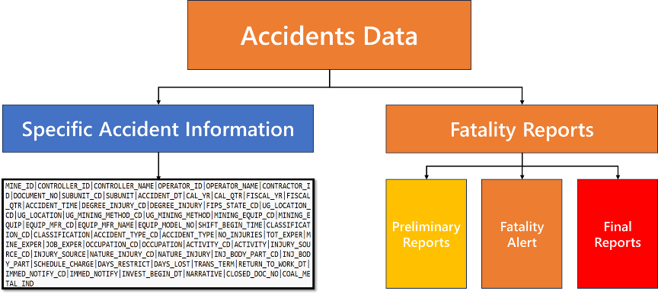
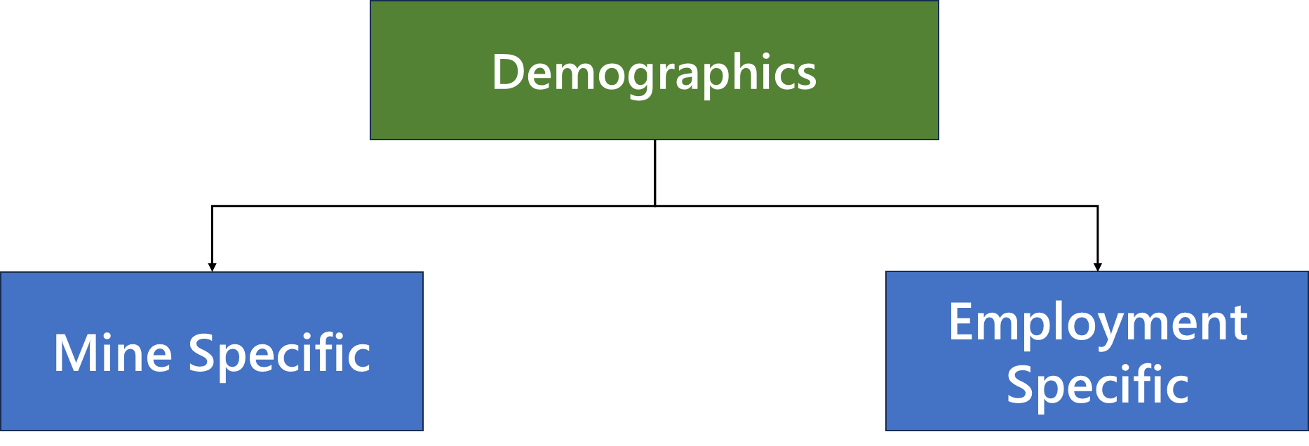
Breakdown of MSHA Database
MSHA DATABASE

Slide 4
What Are the Main Issues with MSHA Database?
Data set is too large
Variety of different factors between mines
Different formats between data sets and in individual datasets
Large amounts of ineffective information
Different refresh rates

Slide 5
Overall Goal of Project
MSHA DATABASE
Visualize
Categorize
Summarize
Predict Future Accidents
Provide actions to help prevent predicted accidents
Mine Operator
Mine ID
Machine Learning Algorithm
Predictive Model

Slide 6
Analysis of 2023 Fatality Data
IS THERE SUFFICIENT INFORMATION IN MSHA’S FATALITY REPORTS?

Slide 7
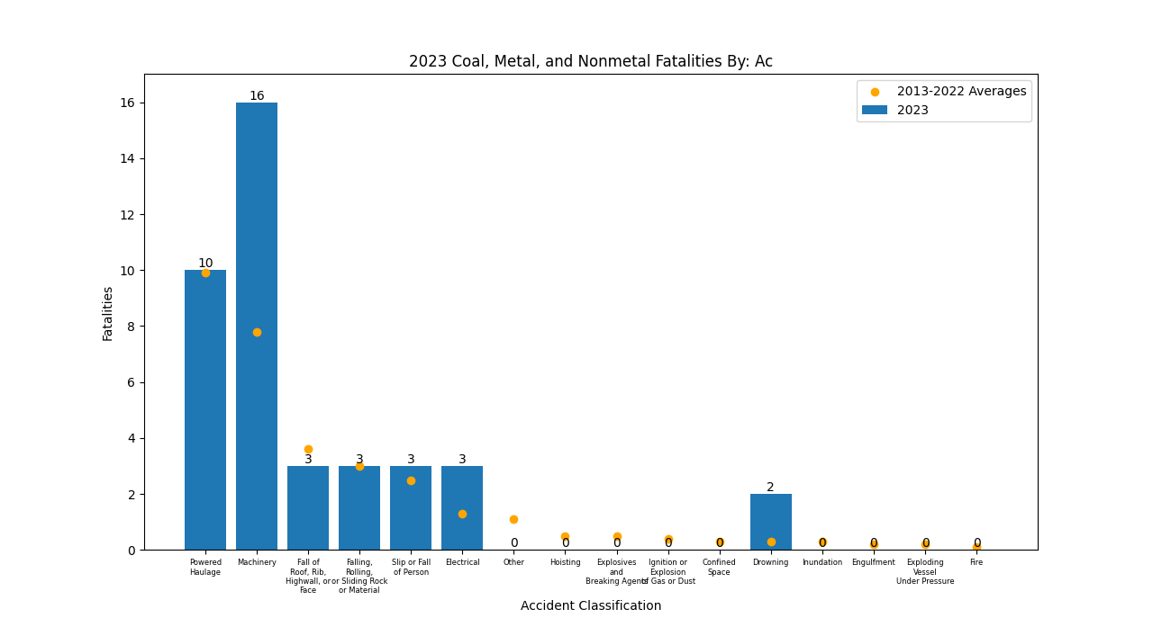
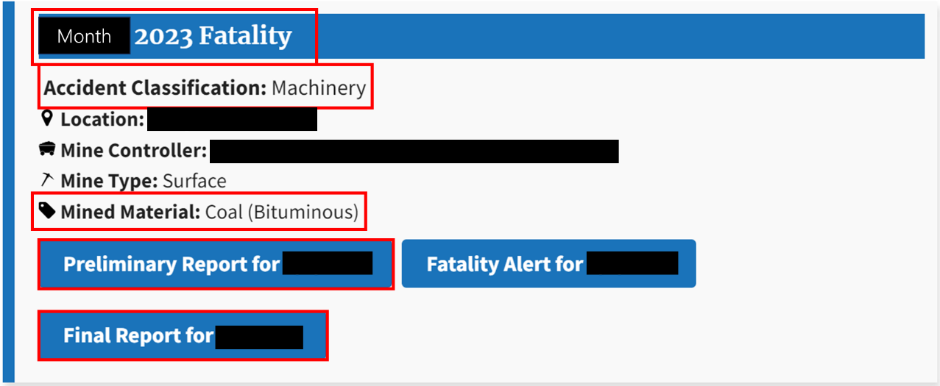
2023 Fatality Case Study
Only Fatality Data
Minimal Automation
Manually Identified Trends

Slide 8
2023 Fatality Data at a Glance
40 Fatalities
28 Nonmetal Fatalities
9 Coal Fatalities
3 Metal Fatalities

Slide 9
Total Mining Fatalities between 2013 and 2023
Notes:
Average at 32
At 40

Slide 10
Coal Industry Fatalities between 2013 and 2023
Notes:
About 12
At 9

Slide 11
Metal and Nonmetal Industry Fatalities between 2013 and 2023
Metal Fatalities
Nonmetal Fatalities
Notes:
Avg=4
At 3

Slide 12
Fatality Rate By Commodity from 2013 to 2023

Slide 13
2023 vs 2013-2022 Average Fatalities – Age
Mining Industry Fatalities
Coal Mining Fatalities

Slide 14
2023 vs 2013-2022 Average Fatalities – Total Experience
Mining Industry Fatalities
Coal Mining Fatalities

Slide 15
Main Observations from Experience and Age Data
Less experienced miners have higher fatality numbers
Trends remained the same with an increased quantity
Watch out for people coming on the mine site

Slide 16
Accident Classification 2023 vs. 2013-2022 Avg
Notes:
This does not include AC below 1 for averages. Machinery is major outlier

Slide 17
Accident Classification by Month

Slide 18
2023 Individual Fatality Breakdown
IS THERE A TREND WITH INDIVIDUAL FATALITY’S FINAL REPORTS?

Slide 19
2023 Individual Fatality Breakdown Procedure
Investigate the “root cause analysis” section of final reports
If a root cause analysis appeared more than once it was given its own category, and if not was put in the “other”
Similar root cause analyses were grouped together

Slide 20
2023 Individual Fatality Breakdown Categories
Conduct a proper workplace examination
Provide proper task training
Block object from hazardous motion
Tag/Mark defective object/condition
Make sure miners wore proper PPE
Prevent travel to unsafe area (on foot)
Prevent travel into unsafe area (machine)
Make sure equipment operator maintained control
Put an adequate procedure in place
Make sure equipment was off/de-energized
Correct hazardous condition
Make sure equipment was used to designed capacity
Comply with approved plan
Other
The mine operator did not:

Slide 21
2023 Individual Fatality for Categories - >15% Occurrence

Slide 22
2023 Individual Fatality Breakdown Divided by Age

Slide 23
2023 Individual Fatality Divided by Age Group

Slide 24
2023 Individual Fatality Divided by Age Group

Slide 25
2023 Individual Fatality Breakdown Divided by Total Experience

Slide 26
2023 Individual Fatality Breakdown Divided by Percentage of Experience Group

Slide 27
2023 Individual Fatality Breakdown Divided by Percentage of Experience Group

Slide 28
2023 Individual Fatality Breakdown: Cause of Fatality

Slide 29
2024 Data Analysis
HOW ARE WE DOING?

Slide 30
2024 Cumulative Fatality Comparison
Notes:
We are on trajectory for a record low year

Slide 31
2024 Cumulative Number of Fatalities – Coal Mining

Slide 32
2024 Fatalities by Accident Classification

Slide 33
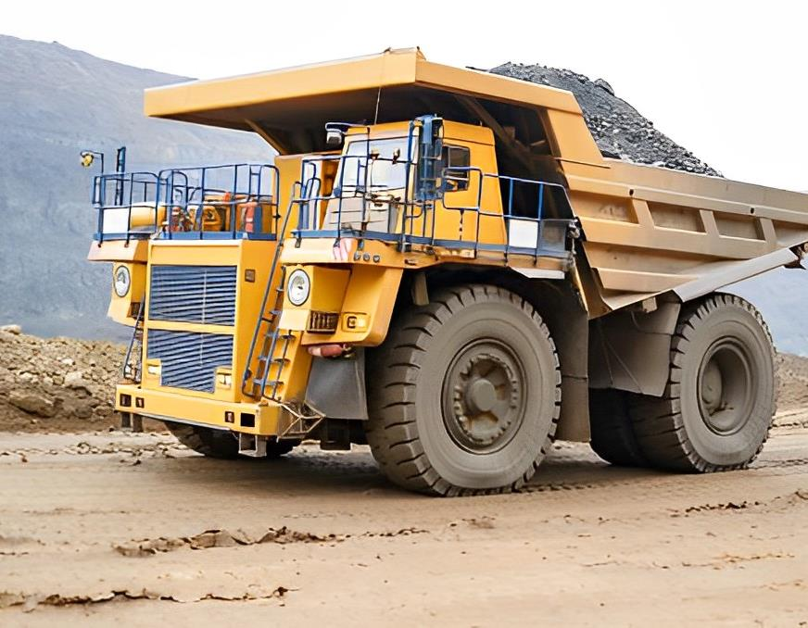
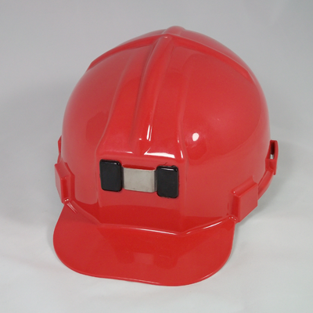
High Likelihood Fatality Areas
Susceptible Areas
Inexperienced Miners
People Visiting the Site
Powered Haulage
https://rmwilson.com/product/low-pro-hard-hat/

Slide 34
Final Takeaways
Single year fatality data can be difficult to interpret due to having to divide 40 entries into smaller categories
Trends are not always evident due to sample size and external factors not recorded
But,
Always important to know where you are, where others are, and what to wear on a mine site
Fatalities do not discriminate by age
Make sure individuals are trained even if they are just visiting

Slide 35
Next Steps
Individual fatality breakdown of multiple years through automation
Incorporate violations and accidents data
Incorporate mine demographics data
Use machine learning to identify trends

Slide 36
Questions?
Email: nathan.kelley@uky.edu

